Slide 1

Chapter 8: PRODUCTION THEORY
How Many Cooks
Spoil the Kitchen?
Production Function
TP, MP & AP
Diminishing Returns & Stages
Returns to Scale, Isoquants & Isocosts
01

Slide 2


THE ROAD AHEAD
Two Questions Every Producer Faces
PART ONE · THE SHORT RUN
PART TWO · THE LONG RUN
Some inputs are stuck. How much of the flexible input should I use?
Everything can change. How big should I grow, and with what mix of inputs?
Total, marginal and average product
Law of diminishing returns
Three stages of production
Hiring rule: MRP = MLC
Returns to scale
Isoquants and MRTS
Isocost lines
Least-cost mix and expansion path
02

Slide 3
A STORY TO START WITH
2
Kavya runs a cloud kitchen. Her lease gives her two stoves and one small room — fixed, for now.
Stoves.
One Small Kitchen.
Orders are pouring in. Her only quick lever is hiring more cooks. Every cook helps — until one day, one doesn’t.
Fixed: stoves (capital)
Variable: cooks (labour)
03

Slide 4



IDEA ONE
The Production Function
The maximum output a given set of inputs can produce, with a given technology, in a given time.
INPUTS
TECHNOLOGY f( )
OUTPUT Q
→
→
Labour (L): cooks
Capital (K): stoves, room
Recipes, workflow, know-how
Meals per hour
Q = f(L, K) or, with many inputs, Q = f(X₁, X₂, …, X_{k})
Technically efficient: No waste: the most meals possible from these cooks and stoves.
Economically efficient: The cheapest input mix for a given number of meals.
04

Slide 5

IDEA ONE, A FAMOUS FORM
The Cobb–Douglas Production Function
Q = A · L^{α} · K^{β}
REAL CASE · 1928
Cobb and Douglas fit this equation to US manufacturing, 1899–1922.
A
technology / efficiency level
Q = 1.01 L^{0.75} K^{0.25}
α, β
output elasticities of labour and capital (0 < α, β < 1)
Exponents add to 1: double both inputs and output doubles (constant returns). A 1% rise in labour lifted output about 0.75%.
α + β
tells us the returns to scale: > 1, = 1 or < 1
05

Slide 6


IDEA ONE, TIME MATTERS
Short Run vs. Long Run
Not a number of months — it depends on whether any input is stuck.
SHORT RUN
LONG RUN
At least one input is fixed.
All inputs can be changed.
Kavya can hire cooks this week, but her two stoves and room are locked by the lease.
When the lease ends, she can take a bigger kitchen, add stoves, or buy machines.
Q = f(L, K̄)
Q = f(L, K)
06

Slide 7



IDEA TWO
Three Ways to Count Output
Using Kavya’s kitchen: 3 cooks make 29 meals an hour; a 4th cook raises it to 39.
Total Product
Marginal Product
Average Product
TP = Q
MP = ΔQ / ΔL
AP = Q / L
All the meals the kitchen makes.
Extra meals from one more cook.
Meals per cook, on average.
With 4 cooks: 39 meals
4th cook: 39 − 29 = 10 meals
4 cooks: 39 ÷ 4 = 9.75 meals
07

Slide 8
IDEA TWO, THE DATA
Kavya’s Kitchen, Cook by Cook
Two stoves fixed; cooks added one at a time.
Cooks (L) | Meals (TP) | MP | AP
0 | 0 | — | —
1 | 8 | 8 | 8.00
2 | 18 | 10 | 9.00
3 | 29 | 11 | 9.67
4 | 39 | 10 | 9.75
5 | 47 | 8 | 9.40
6 | 52 | 5 | 8.67
7 | 56 | 4 | 8.00
8 | 52 | -4 | 6.50
MP peaks at the 3rd cook
He adds 11 meals — more than anyone before or after.
AP peaks at 4 cooks
9.75 meals per cook — the best average.
The 8th cook hurts output
MP turns negative: 56 meals fall to 52.
08

Slide 9
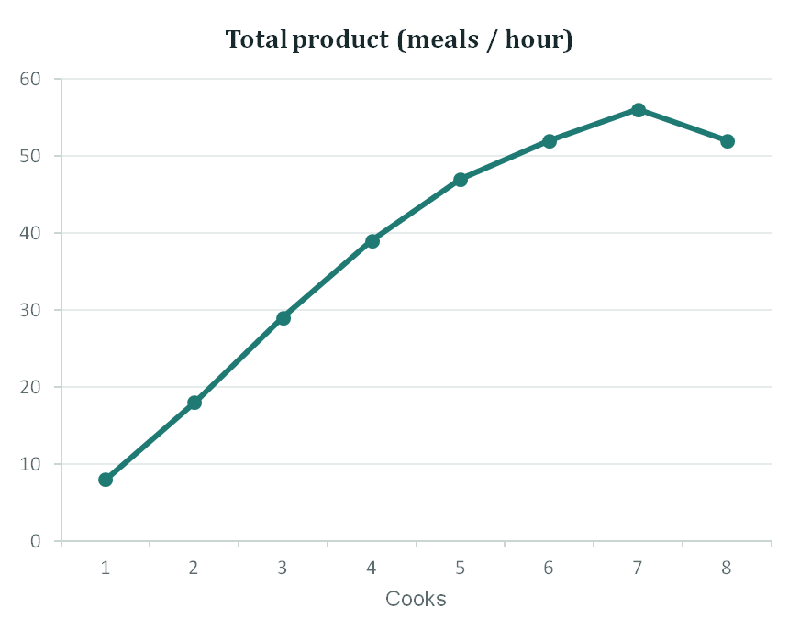
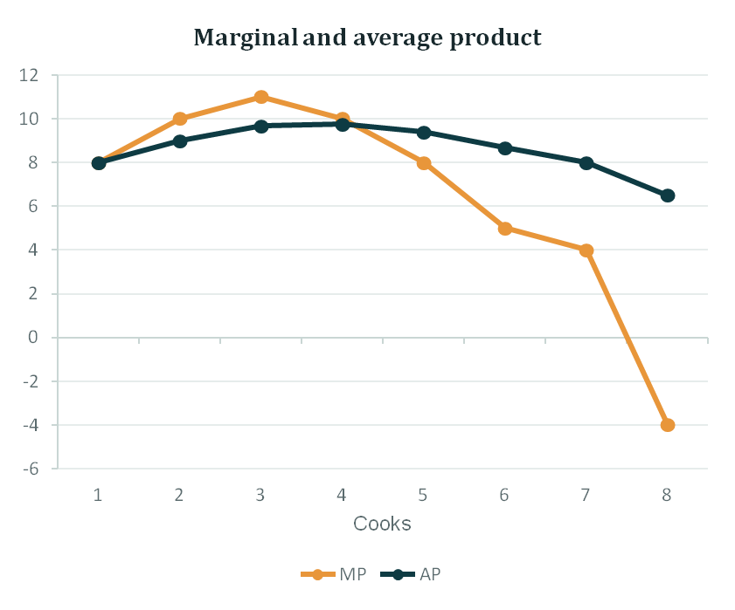
IDEA TWO, THE PICTURE
What the Curves Show
09

Slide 10

IDEA TWO, THE RULES
How the Three Curves Move Together
MP AND TP
THINK OF A BATTER’S AVERAGE
MP > 0
TP rises
MP = 0
TP is at its maximum
A batter averaging 40 scores 70 in the next innings. The average goes up. If she scores 10, it goes down.
MP < 0
TP falls
MP AND AP
The next innings is the marginal. Kavya’s 5th cook adds 8 meals when the average is 9.75 — so the average falls to 9.4.
MP > AP → AP rises
MP < AP → AP falls
MP = AP at the peak of AP
10

Slide 11
IDEA TWO, IN PERCENTAGES
Output Elasticity of Labour
E_{L} = %ΔQ / %ΔL
KAVYA’S KITCHEN · 2 COOKS
1.11
MP 10 ÷ AP 9
= MP_{L} / AP_{L}
Output grows faster than the team
How strongly output responds, in percentage terms, to more labour.
KAVYA’S KITCHEN · 6 COOKS
0.58
MP 5 ÷ AP 8.67
E > 1: output grows faster than labour. E < 1: slower.
Output grows slower than the team
11

Slide 12
BUT…
The 4th Cook Starts Bumping Elbows.
11
10
10
THE LAW OF DIMINISHING RETURNS
8
8
Keep adding a variable input to a fixed input, and at some point each extra unit adds less output than the one before.
5
4
Two stoves can only hold so many pans. After the 3rd cook, every new cook adds fewer meals.
1
2
3
4
5
6
7
Extra meals from each new cook
12

Slide 13


IDEA THREE, THE REASONS
Why Output Rises Fast, Then Slows
FIRST: RISING RETURNS
THEN: DIMINISHING RETURNS
Specialisation and teamwork
Crowding a fixed input
REAL CASE · ADAM SMITH, 1776
REAL CASE · BROOKS’S LAW, 1975
In a pin factory, ten workers splitting 18 steps made about 48,000 pins a day. Working alone, each could hardly make 20.
Fred Brooks, managing IBM’s OS/360 project, found that adding programmers to a late project made it later — more people, more coordination, same deadline.
13

Slide 14
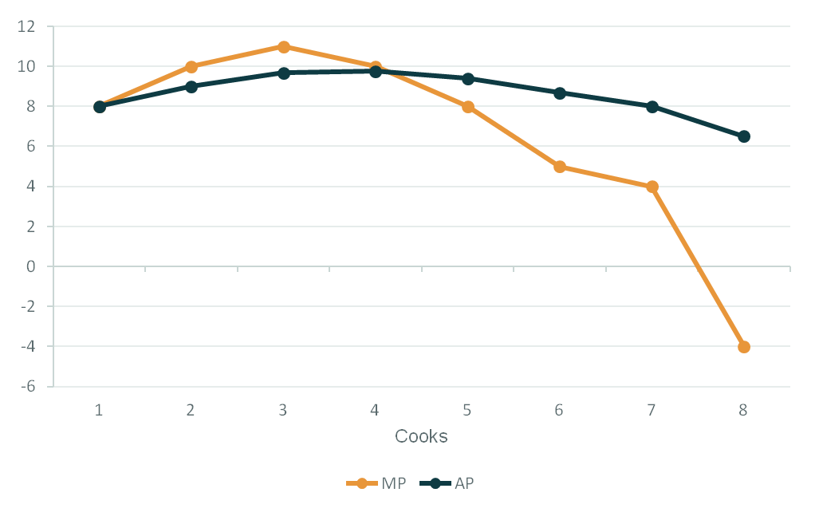
IDEA THREE, THE STAGES
The Three Stages of Production
Stage I: to 4 cooks
Stage II: 4 to ~7
Stage III: beyond
Stage I
From zero until AP peaks
Up to 4 cooks
Stage II
From peak AP until MP = 0
4 to about 7 cooks
Stage III
MP is negative
The 8th cook onwards
14

Slide 15




IDEA THREE, THE CHOICE
Why a Sensible Firm Stays in Stage II
Too few
Just right
Too many
Not Stage I
Stage II
Not Stage III
The stoves are under-used. Each new cook still raises meals per cook — so keep hiring.
Output is still rising, but each cook adds less. This is where the real decision is made.
More cooks, fewer meals. You pay extra to produce less.
Real case — disguised unemployment: on many small Indian family farms, more relatives work the same plot than it needs. Withdraw a few and output barely changes — their marginal product is close to zero.
15

Slide 16
PRACTICE
Worked answer
Find the Stages
1
Write MP and AP
QUESTION
MP = 150 + 36L − 4.5L²; AP = 150 + 18L − 1.5L²
Q = 150L + 18L² − 1.5L³
2
Diminishing returns: MP at its peak
dMP/dL = 36 − 9L = 0 → L = 4
Q = output per week, L = workers.
a. When do diminishing returns set in?
b. Find the labour ranges for Stages I, II and III.
3
Stage I ends: AP at its peak
dAP/dL = 18 − 3L = 0 → L = 6 (MP = AP = 204)
4
Stage II ends: MP = 0
4.5L² − 36L − 150 = 0 → L ≈ 11.02
Stage I: 0–6 · Stage II: 6–11.02 · Stage III: beyond 11.02
16

Slide 17


IDEA FOUR
MRP = MLC
Where in Stage II? Follow the Money
Kavya’s friend Ravi runs a small paper-cup unit. His machines are fixed. Cups sell for ₹2 each; a worker costs ₹10,000 a month. How many should he hire?
MRP
MLC
Marginal revenue product
Marginal labour cost
Extra revenue from one more worker
MRP = P × MP
Extra cost of one more worker
MLC = w (the wage)
Rule: keep hiring while a worker brings in more than he costs. Stop where MRP = MLC.
17

Slide 18
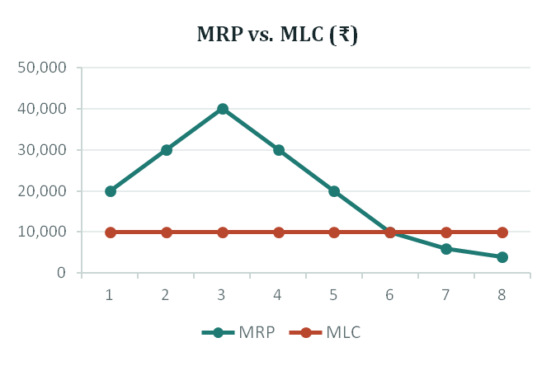
IDEA FOUR, THE NUMBERS
Ravi Hires 6 Workers
P = ₹2 per cup · w = ₹10,000 per worker per month
L | Cups (Q) | MP | MRP (₹) | MLC (₹) | MRP − MLC
1 | 10,000 | 10,000 | 20,000 | 10,000 | 10,000
2 | 25,000 | 15,000 | 30,000 | 10,000 | 20,000
3 | 45,000 | 20,000 | 40,000 | 10,000 | 30,000
4 | 60,000 | 15,000 | 30,000 | 10,000 | 20,000
5 | 70,000 | 10,000 | 20,000 | 10,000 | 10,000
6 | 75,000 | 5,000 | 10,000 | 10,000 | 0
7 | 78,000 | 3,000 | 6,000 | 10,000 | -4,000
8 | 80,000 | 2,000 | 4,000 | 10,000 | -6,000
6th worker: brings ₹10,000, costs ₹10,000.
7th worker: brings ₹6,000, costs ₹10,000.
Grey rows: Stage I (AP still rising). Highlighted: the optimum.
18

Slide 19
PRACTICE
Worked answer
The Calculator Maker
1
Marginal product
QUESTION
MP = dQ/dL = 98 − 6L
A small calculator maker has fixed plant but can vary workers.
2
Marginal revenue product
Q = 98L − 3L²
MRP = P × MP = 20(98 − 6L)
3
Marginal labour cost
Each calculator sells for ₹20. Each worker costs ₹40 a day. How many workers maximise profit?
MLC = w = 40
4
Set MRP = MLC
20(98 − 6L) = 40 → 98 − 6L = 2
L = 16 workers
19

Slide 20


PART TWO · THE LONG RUN
Two Years Later, the Lease Is Up.
Now nothing is fixed. Kavya faces two new questions.
How big?
What mix?
If she doubles cooks, stoves and space, will meals double, more than double, or less?
For 60 meals an hour: many cooks and few machines, or fewer cooks and more machines? Which is cheapest?
Returns to scale
Isoquants & isocosts
20

Slide 21


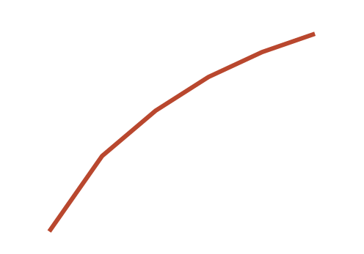
IDEA FIVE
Returns to Scale
Scale every input by h. Output scales by λ: f(hL, hK) = λQ
Increasing
λ > h
Constant
λ = h
Decreasing
λ < h
Double inputs → output more than doubles
Double inputs → output exactly doubles
Double inputs → output less than doubles
Output elasticity E > 1
Output elasticity E = 1
Output elasticity E < 1
21

Slide 22



IDEA FIVE, IN THE REAL WORLD
Why Scale Helps — Then Hurts
Increasing
Constant
Decreasing
Size advantages
Copy-paste growth
Coordination strain
Double a ship’s length, width and height: it carries about 8× the cargo but needs only about 4× the steel for its hull. Bigger crews also specialise.
Kavya opens a second identical kitchen with the same cooks, stoves and menu. Twice the inputs, about twice the meals.
At 20 kitchens, she needs managers, audits and approvals. Information travels slower and decisions take longer.
Typical long-run pattern: increasing → constant → decreasing returns as a firm grows.
22

Slide 23
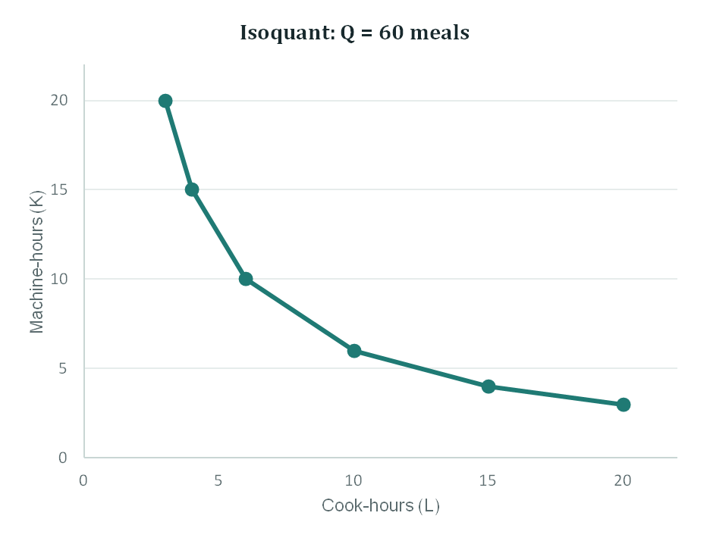
IDEA SIX
Isoquants: Many Ways to Make 60 Meals
An isoquant joins every input mix that gives the same output.
Mix | Cook-hours (L) | Machine-hours (K) | Meals
A | 3 | 20 | 60
B | 4 | 15 | 60
C | 6 | 10 | 60
D | 10 | 6 | 60
E | 15 | 4 | 60
F | 20 | 3 | 60
Mix A leans on machines; mix F leans on cooks. Both make 60 meals.
23

Slide 24




IDEA SIX, THE PROPERTIES
Four Rules Every Isoquant Follows
Higher is more
They slope down
Isoquants further from the origin mean more output.
Use more cooks, and fewer machines are needed for the same meals.
They never cross
They bow inward
One mix cannot produce two different outputs at once.
Convex to the origin: substituting gets harder as one input runs low.
Economic region: firms use only the downward-sloping part. Where an isoquant bends upward, extra input lowers output — Stage III again.
24

Slide 25
IDEA SIX, THE SLOPE
Marginal Rate of Technical Substitution
Move | ΔL | ΔK | MRTS
A → B | +1 | −5 | 5.0
B → C | +2 | −5 | 2.5
C → D | +4 | −4 | 1.0
D → E | +5 | −2 | 0.4
E → F | +5 | −1 | 0.2
MRTS = −ΔK / ΔL
= MP_{L} / MP_{K}
Machine-hours Kavya can give up for one more cook-hour, keeping meals at 60.
Why MP ratio? Staying on the isoquant means ΔQ = MP_{L}·ΔL + MP_{K}·ΔK = 0.
Diminishing MRTS: with few cooks, one more frees up 5 machine-hours. With plenty of cooks, one more frees up only 0.2.
25

Slide 26
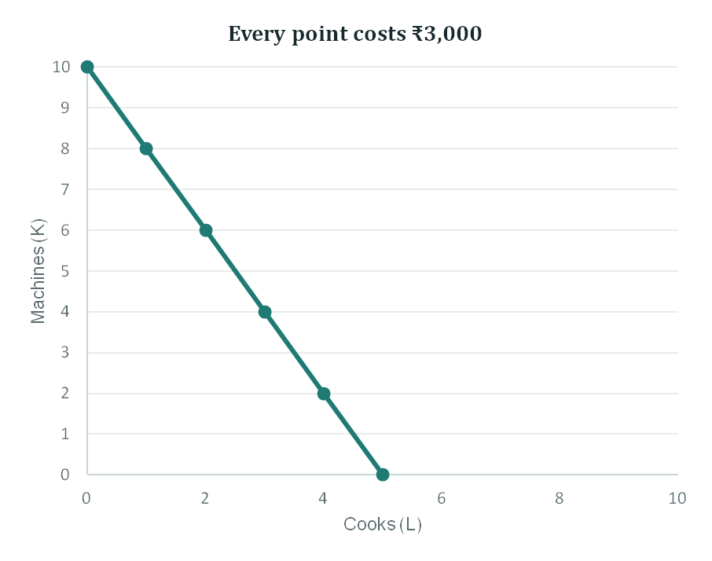
IDEA SEVEN
The Isocost Line: What Kavya Can Afford
C = wL + rK
K = C/r − (w/r)·L
Budget: C = ₹3,000 a day
Cook wage: w = ₹600 a day
Machine rent: r = ₹300 a day
Slope: −w/r = −2
26

Slide 27
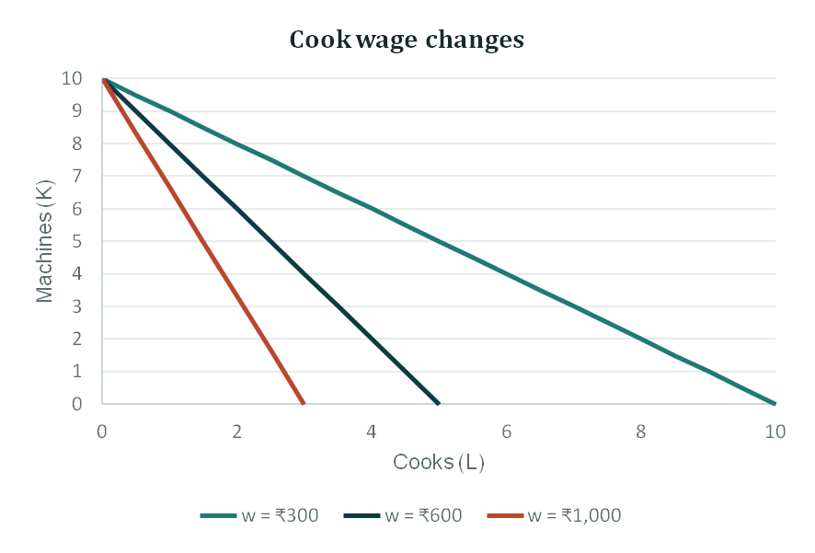
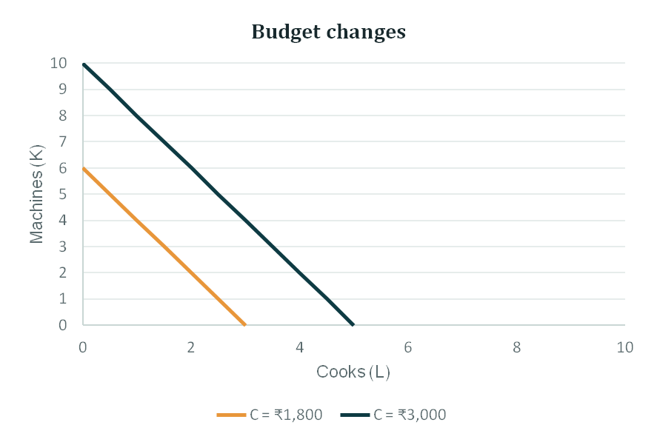
IDEA SEVEN, WHEN THINGS CHANGE
Prices Rotate the Line; Budgets Shift It
Real pattern: where wages are low relative to machine rent, firms use more workers; as wages rise, they switch to machines.
27

Slide 28
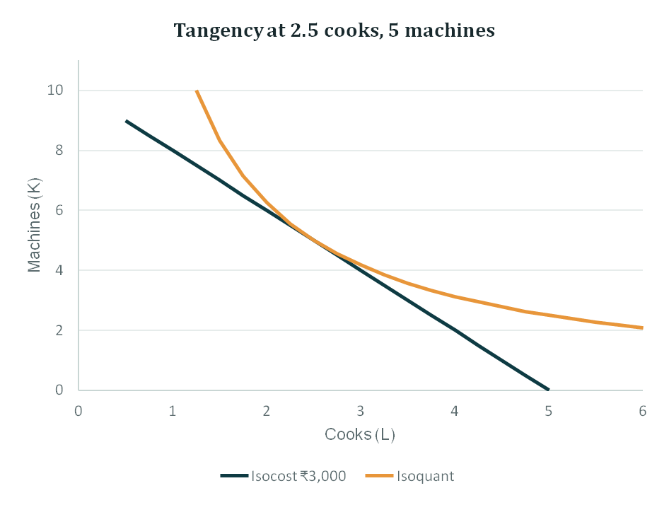
IDEA EIGHT
The Cheapest Mix: Where the Lines Touch
THE LEAST-COST RULE
MRTS = w / r
MP_{L} / w = MP_{K} / r
IN PLAIN WORDS
The last rupee spent on cooks must buy as many meals as the last rupee spent on machines. If cooks give more meals per rupee, shift money towards cooks.
28

Slide 29
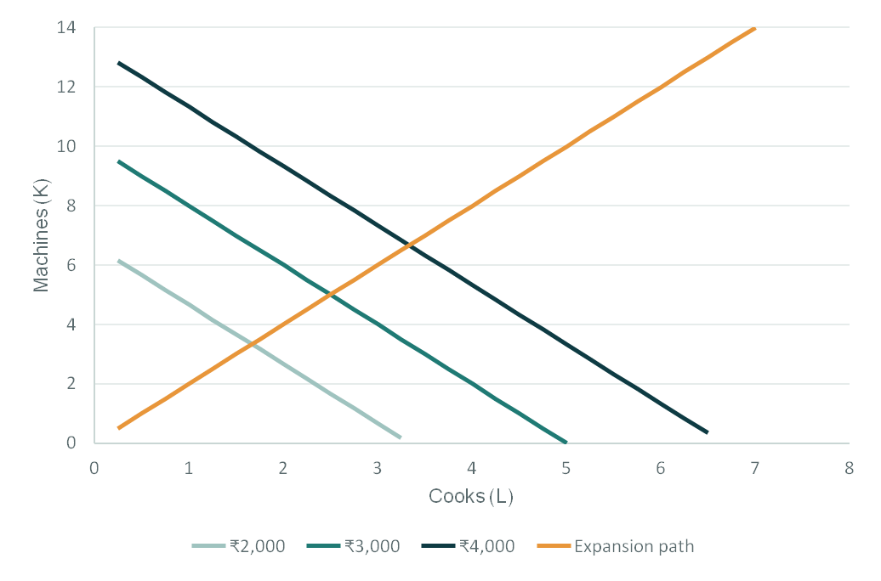
IDEA EIGHT, GROWING
The Expansion Path
Join the least-cost points as the budget grows, with prices unchanged.
1.67 cooks, 3.33 machines
₹2,000
2.5 cooks, 5 machines
₹3,000
3.33 cooks, 6.67 machines
₹4,000
Prices fixed → MRTS stays at w/r = 2 → Kavya keeps 2 machines per cook as she grows.
29

Slide 30
PRACTICE
Worked answer
Is the Lawn Service Minimising Cost?
3.0 lawns per ₹1,000
Push mower
QUESTION
A lawn-care firm rents 5 push mowers and 2 riding mowers.
MP / price = 3 ÷ 1,000
2.4 lawns per ₹1,000
Push mower
MP = 3 lawns/day · Rent ₹1,000/day
Riding mower
MP / price = 6 ÷ 2,500
Riding mower
MP = 6 lawns/day · Rent ₹2,500/day
Not cost-minimising. Push mowers give more lawns per rupee. Rent more push mowers and fewer riding mowers until MP per rupee is equal.
Is this the least-cost mix? If not, what should change?
30

Slide 31
PUTTING IT TOGETHER
Kavya’s Decision Map
SHORT RUN
LONG RUN
Stoves fixed. Choose the number of cooks.
Everything flexible. Choose size and mix.
1
Stay in Stage II
between peak AP and MP = 0
1
Grow while returns to scale are increasing
and watch for coordination strain
2
Hire until MRP = MLC
extra revenue = extra cost
2
Mix inputs where MP_{L}/w = MP_{K}/r
then follow the expansion path
31

Slide 32




WRAPPING UP
Key Takeaways
01
02
A production function gives the maximum output from inputs; Cobb–Douglas exponents reveal elasticities and scale.
With one input fixed, MP eventually falls. MP above AP pulls AP up; MP below AP pulls it down.
03
04
Operate in Stage II, and hire until MRP = MLC.
In the long run, pick the mix where MP_{L}/w = MP_{K}/r, and grow along the expansion path.
32

Slide 33
QUICK RECAP
True or False?
1
When MP starts to fall, total product starts to fall.
TP falls only when MP < 0.
FALSE
2
If MP is above AP, AP must be rising.
Like a batting average.
TRUE
3
A rational firm may operate in Stage III to maximise output.
More input, less output.
FALSE
4
In Q = L^{0.6}K^{0.5}, doubling both inputs more than doubles output.
0.6 + 0.5 > 1: increasing RTS.
TRUE
33

Slide 34


YOUR TURN
You Decide
CASE A
CASE B
A tea stall has one counter. With 1, 2, 3 and 4 helpers it serves 60, 140, 190 and 210 cups an hour. Tea sells at ₹10; a helper costs ₹300 an hour.
A garment unit finds that the last ₹1,000 spent on workers adds 50 shirts, while the last ₹1,000 on sewing machines adds 80.
DISCUSS
DISCUSS
Find MP. Where do diminishing returns start? How many helpers should it hire?
Is it cost-minimising? Which way should it shift spending, and what happens to MRTS?
34

